Slide 1
Electromagnetic Waves
30th NOVEMBER 2020

Slide 2
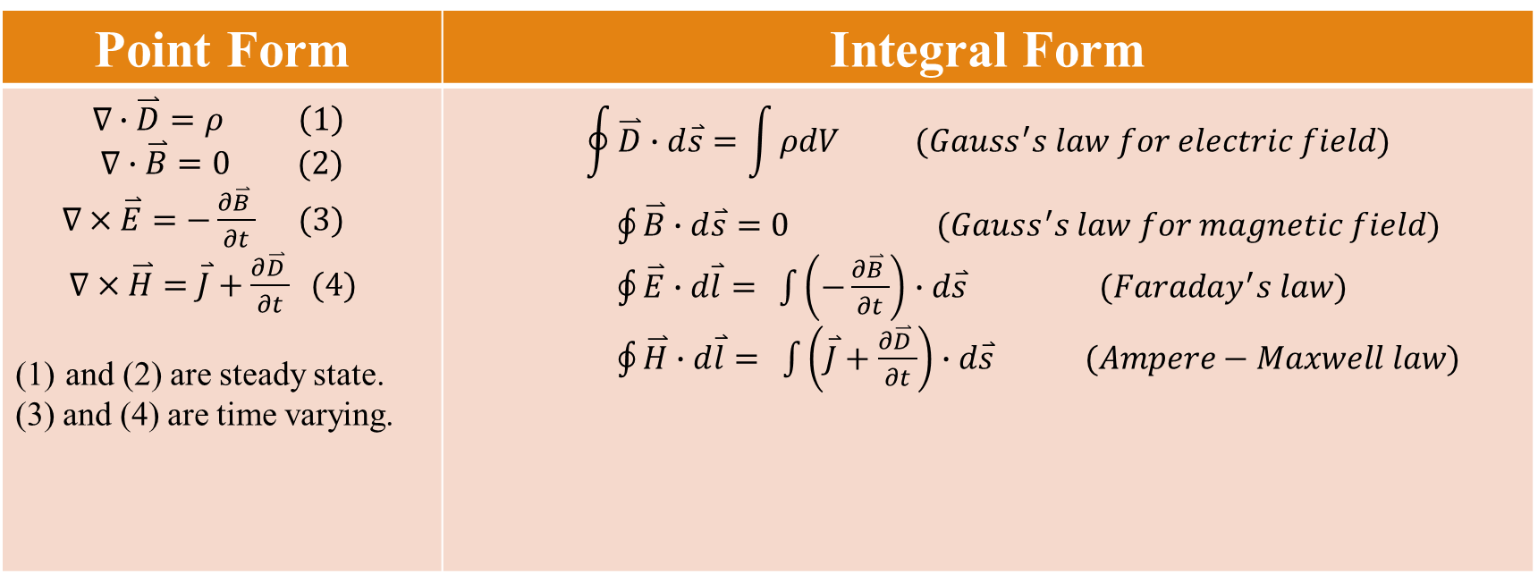
Maxwell’s Equations, General Set
Point Form | Integral Form
$$∇∙\overset{⃑}{D}=ρ \left(1\right)$$ $$∇∙\overset{⃑}{B}=0 (2)$$ $∇×\overset{⃑}{E}=−\frac{∂\overset{⃑}{B} }{∂t} (3)$ $∇×\overset{⃑}{H}=\overset{⃑}{J}+\frac{∂\overset{⃑}{D} }{∂t} (4)$ and (2) are steady state. (3) and (4) are time varying. | $$\oint{\overset{⃑}{D}}∙d\overset{⃑}{s}=\int{ρdV (Gauss^{′}s law for electric field)}$$ $\oint{\overset{⃑}{B}}∙d\overset{⃑}{s}=0$ $(Gauss^{′}s law for magnetic field)$ $\oint{\overset{⃑}{E}}∙d\overset{⃑}{l}=$ $\int{\left(−\frac{∂\overset{⃑}{B} }{∂t}\right)}$ $∙d\overset{⃑}{s}$ $(Faraday^{′}s law)$ $\oint{\overset{⃑}{H}}∙d\overset{⃑}{l}=$ $\int{\left(\overset{⃑}{J}+\frac{∂\overset{⃑}{D} }{∂t}\right)}$ $∙d\overset{⃑}{s} (Ampere−Maxwell law)$
Notes:
E = electric field (V/m)
H = magnetic field (A/m)
B = magnetic flux density (Wb/m^2)
D = electric flux density (C/m^2)
J = current density (A/m^2)
= volume charge density (c/m^3)
สำหรับสมการที่ 1 และ 2 the field don’t vary with time, such as electric field produced by charges at rest or magnetic field of a steady current, the electric and magnetic fields independently without interaction between them.
สำหรับสมการที่ 3 และ 4 when the field vary with time a time-varying magnetic field acts as a source of electric field.
Gauss’ Law: The total electric flux coming out of a closed surface is equal to the total charge enclosed by that closed surface (irrespective of the shape of the closed surface) Points to Note: This law establishes charges as the “sources” or “sinks” of the electric field (i.e. charges produce or terminate electric field lines).
Gauss’ Law for the Magnetic Fields: The total magnetic flux coming out of a closed surface is always zero. Points to Note: This law implies that there are no such things as “magnetic charges” that can emanate or terminate magnetic field lines.
Faraday’s Law: The line integral of electric field over a closed contour is equal to –ve of the time rate of change of the total magnetic flux that goes through any arbitrary surface that is bounded by the closed contour Points to Note: This law says that time changing magnetic fields can also generate electric fields
Ampere’s Law: The line integral of magnetic field over a closed contour is equal to the total current plus the time rate of change of the total electric flux that goes through any arbitrary surface that is bounded by the closed contour Points to Note: This law says that electrical currents and time changing electric fields can generate magnetic fields. Since there are no magnetic charges, this is the only known way to generate magnetic fields
Ref https://courses.cit.cornell.edu/ece303/Lectures/lecture2.pdf

Slide 3
Significance of the Maxwell’s equations
The two time-varying equations are mathematically sufficient to produce separate wave equations for the electric and magnetic field vectors.
Also, they indicates time variable E and H fields cannot exist independently.
The steady state equations help to identify the wave nature as transverse.
Two constitutive equations are needed for solving the Maxwell’s equations.
Notes:
= permittivity : the measure of the resistance that is encountered when forming an electric field in the medium
μ = permeability : the degree of magnetization of a material in response to a magnetic field. Or the measure of the ability of material to support the forming of a magnetic field within itself.

Slide 4
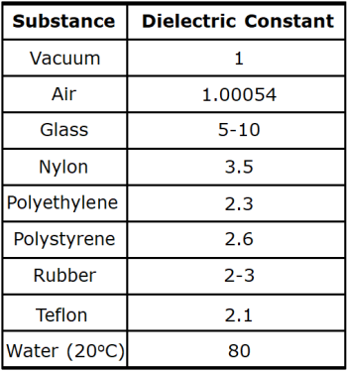
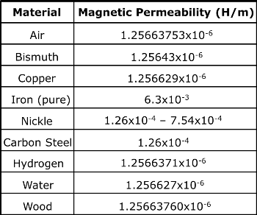
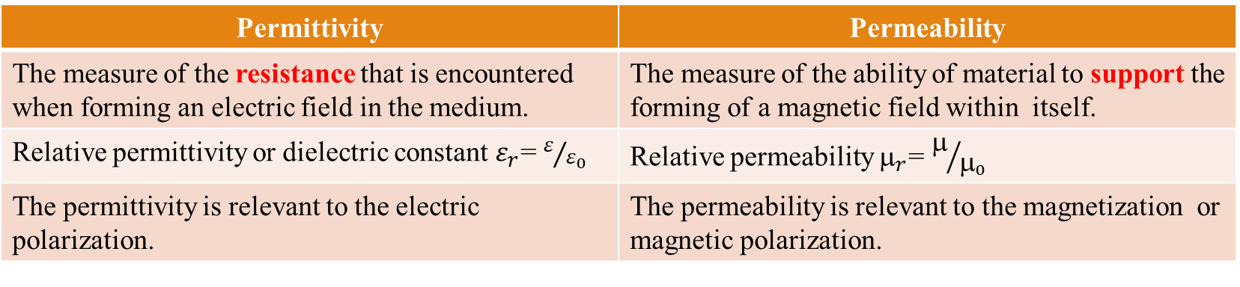
Permittivity (ε) and permeability (μ)
Permittivity | Permeability
The measure of the resistance that is encountered when forming an electric field in the medium. | The measure of the ability of material to support the forming of a magnetic field within itself.
Relative permittivity or dielectric constant $ε_{r}$= $ε/{ε_{0}}$ | Relative permeability $_{r}$= $/{_{0}}$
The permittivity is relevant to the electric polarization. | The permeability is relevant to the magnetization or magnetic polarization.
https://study.com/academy/lesson/what-is-permittivity-definition-examples.html
Notes:
The magnetic permeability of the material is directly proportional to the number of lines passing through it. The permeability of the air or vacuum is represented by μ₀ which is equal to 4π×17⁻⁷ H/m. The permeability of air or vacuum is very poor. μ represents the magnetic permeability.
https://circuitglobe.com/difference-between-permittivity-and-permeability.html this website compare between permittivity and permeability
Permittivity varies significantly as a function of frequency and temperature.
Note: water is a good dielectric because it has a high dielectric constant. However, for the household water, it is conductive because it usually contains several kind of ions i.e. Na+ and Cl- from NaCl.

Slide 5
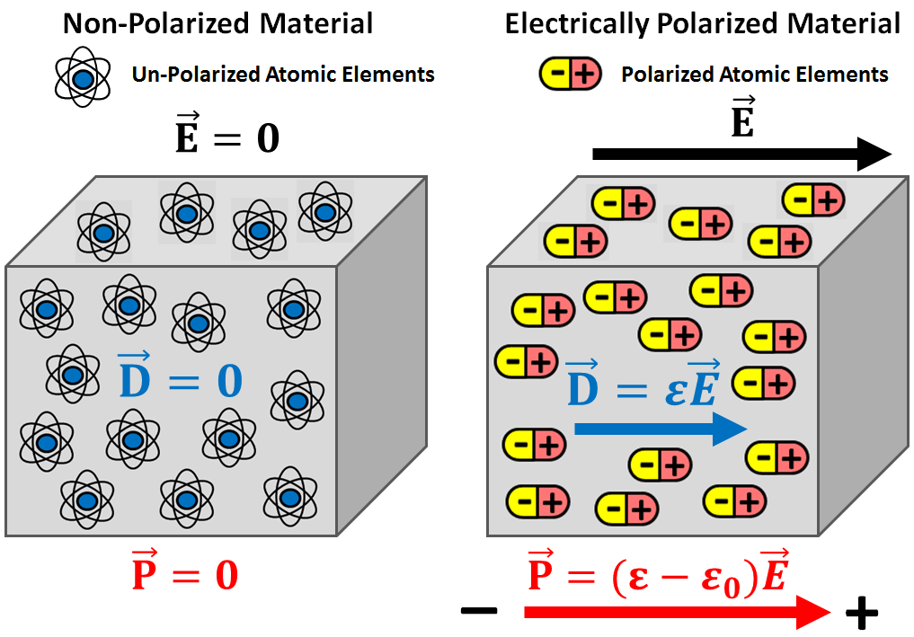
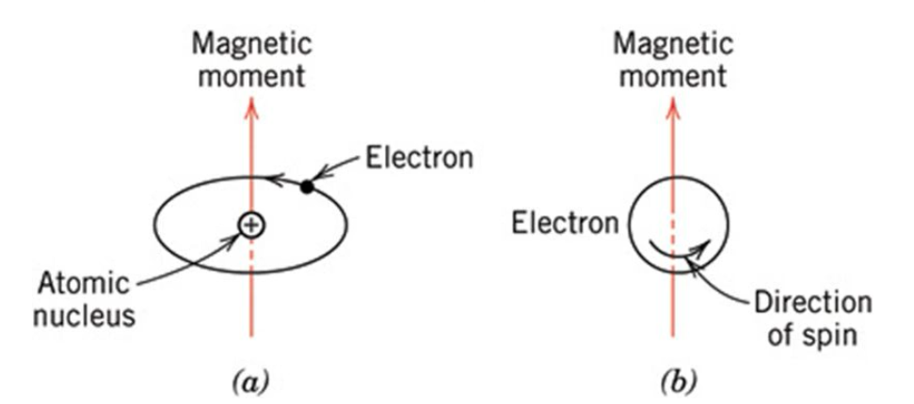
Origin of polarization
Origin of magnitization
https://em.geosci.xyz/_images/electric_polarization_physics_diagram.png
https://slideplayer.com/slide/8700248/
Notes:
Sources of magnetic moment : orbital motion around the nucleus and spin
In classical electromagnetism, magnetization or magnetic polarization is the vector field that expresses the density of permanent or induced magnetic dipole moments in a magnetic material.
The origin of the magnetic moments responsible for magnetization can be either microscopic electric currents resulting from the motion of electrons in atoms, or the spin of the electrons or the nuclei.
The magnetic moment is the magnetic strength and orientation of a magnet or other object that produces a magnetic field

Slide 6
Scopes of study
Electromagnetic waves in a medium having finite permeability μ and permittivity ε but with conductivity σ = 0,
The wave equation for electromagnetic Waves in a dielectric,
Impedance of a dielectric to electromagnetic Waves,
Electromagnetic waves in a medium of properties μ, ε and σ (where σ ≠ 0 ),
Electromagnetic wave velocity in a conductor and anomalous dispersion,

Slide 7
Electromagnetic waves in a medium having finite permeability μ and permittivity ε but with conductivity σ = 0
Given conditions
The properties (eg. amplitude, phase, frequency, wavelength and speed) of the chosen plane waves in xy plane are constant,
These properties will not vary with respect to x and y and all derivatives ∂/∂x and ∂/∂y will be zero.
In dielectric such as free space, no charge (ρ = 0) and no current density (J = 0).
Notes:
The main properties of wave include amplitude, phase, frequency, wavelength and speed.
The wave front is in xy plane and propagating in z direction.

Slide 8

Maxwell’s equations in dielectric
(1A)
$$∇∙\overset{⃑}{D}=ρ \left(1\right)$$
$$∇∙\overset{⃑}{B}=0 (2)$$
$∇×\overset{⃑}{E}=−\frac{∂\overset{⃑}{B} }{∂t}=−μ\frac{∂\overset{⃑}{H} }{∂t} (3)$
$∇×\overset{⃑}{H}=\frac{∂\overset{⃑}{D} }{∂t}=ε\frac{∂\overset{⃑}{E} }{∂t} (4)$
(2A)
(3A)
(4A)

Slide 9
The wave equation of electromagnetic waves in a dielectric
Since, with these plane waves, all derivatives with respect to x and y are zero. Equations (2A) and (3A) give
This implies that H_{z} is constant in space and time.
H_{z} has no effect on the wave motion. For simplicity, put H_{z} = 0.
A similar consideration of equations (1A) and (4A) leads to E_{z} = 0.
The above results suggest that the oscillations in H and E occur in direction perpendicular to z-direction. In other words, the EM plane wave is transverse.

Slide 10
The wave equation for electromagnetic waves in a dielectric : plane-polarized waves (1)
Consider E_{x} only, with E_{y} = 0, equations (3A) and (4A) give
Using the fact that
The wave equation for H_{y} is found to be
Similarly, the wave equation for E_{x} is
Notes:
The plane wave is said to be linearly polarized because the electric vector is always along the x axis and similarly, the magnetic vector is always along the y axis.

Slide 11
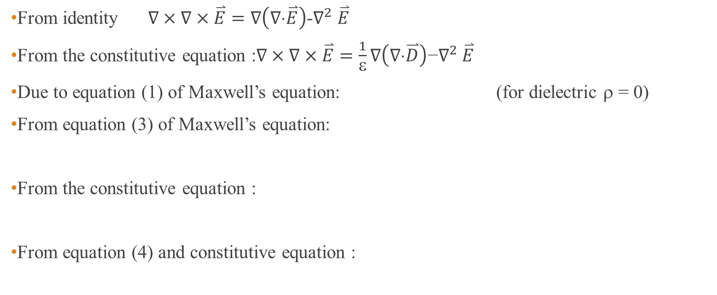
Recall a formal derivation of the wave equation from Maxwell’s equations in dielectric (1)
From identity $∇×∇×\overset{⃑}{E}=∇\left(∇⋅\overset{⃑}{E}\right)$-$∇^{2}$ $\overset{⃑}{E}$
From the constitutive equation :$∇×∇×\overset{⃑}{E}=\frac{1}{ε}∇\left(∇⋅\overset{⃑}{D}\right)\text{−}∇^{2} \overset{⃑}{E}$
Due to equation (1) of Maxwell’s equation: (for dielectric ρ = 0)
From equation (3) of Maxwell’s equation:
From the constitutive equation :
From equation (4) and constitutive equation :

Slide 12
Recall a formal derivation of the wave equation from Maxwell’s equations in dielectric (2)
The wave equation
Possible solution for the wave equation may be given as
By substituting the solution in the wave equation, we obtain
Finally, the wave equation in free space becomes
Notes:
Laplacian = divergence of the gradient of a function

Slide 13

The wave equation for electromagnetic Waves in dielectric : plane-polarized waves (2)
The vector E_{x} and H_{y} obey the same wave equation.
In free space, the velocity is that of light given as
Solutions of the wave equations
The vector product gives direction of the energy flow. This can be seen from the product dimension:
$$E_{x}=E_{0}\sin{\frac{2π}{λ}}\left(vt−z\right)$$
$$H_{y}=H_{0}\sin{\frac{2π}{λ}}\left(vt−z\right)$$
H_{y}
Notes:
The solutions represent the EM wave propagates in the z direction.
Notice that electric field intensity and magnetic field intensity are in phase. (in the case of wave propagation in dielectric)

Slide 14
Plane electromagnetic waves
(a) The electric field E, magnetic field B and propagation vector k are everywhere mutually perpendicular
(b) Wave fronts for a linear polarized plane electromagnetic wave
F Pedrotti et. al. “Introduction to optics”, 3ed., Pearson international ( 2007)
Notes:
Material that can support this relationship is known as right handed material.

Slide 15
Energy density of electromagnetic wave in free space
An electromagnetic wave represents the transmission of energy.
The energy density, in J/m³ , for electric field u_{E} and magnetic field u_{B} in free space are given as
At any specified time and place, the two field are related by E = cB .
This gives u_{E} = u_{B} and the total energy density is u = u_{E} + u_{B} = 2u_{E} = 2u_{B}
Or

Slide 16
Poynting vector (1)
Consider the power or the rate at which energy is transported by the electromagnetic wave.
Energy flow of an EM wave in time Δt. The energy enclosed in the rectangular volume ΔV flows across the surface A.
Therefore, power transferred per unit area S is
Notes:
Poynting vector = rate of energy transfer

Slide 17
Poynting vector (2)
The power per unit area in terms of E and B is given as
The power unit area, S, when assigned the direction of propagation, is called Poynting vector. This can be written as
Time average of the power per unit area called irradiance is given as
Notes:
I = the time average of the magnitude of the poynting vector

Slide 18
Problem : Poynting vector (energy flow in w/m²)
The plane polarized electromagnetic wave (E_{x}, H_{y}) travels in free space.
Show that its Poynting vector is given by
Where c is the velocity of light.
Determine the intensity in such a wave.

Slide 19
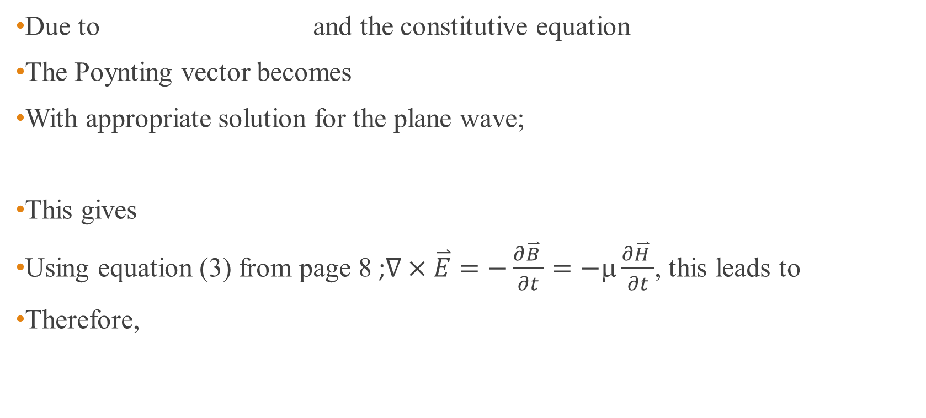
Solution
Due to and the constitutive equation
The Poynting vector becomes
With appropriate solution for the plane wave;
This gives
Using equation (3) from page 8 ;$∇×\overset{⃑}{E}=−\frac{∂\overset{⃑}{B} }{∂t}=−μ\frac{∂\overset{⃑}{H} }{∂t}$, this leads to
Therefore,
Notes:
Equation (3) from page 8

Slide 20
Solution
The intensity of this wave can be calculated from

Slide 21
Problem : average irradiance
A laser beam of radius 1 mm carries a power of 6 kW.
Determine its average irradiance and the amplitude of its E and B fields.

Slide 22
Solution
The average irradiance can be found from power/area = 1.91 x 10⁹ W/m²
From the irradiance , the amplitude of E field is found to be 1.20 x 10⁶ V/m
Due to the relationship E = cB, the amplitude of B field becomes 4.00 x 10⁻³ T

Slide 23
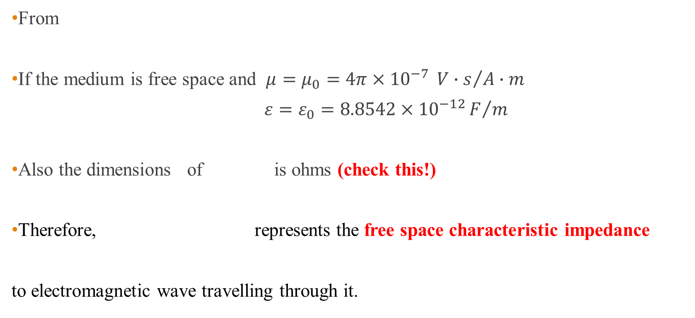
Impedance of a dielectric to electromagnetic Waves
Z=
From
If the medium is free space and $μ=μ_{0}=4π×{10}^{−7} {V∙s}/{A∙m}$
$ε=ε_{0}=8.8542×{10}^{−12}F/m$
Also the dimensions of is ohms (check this!)
Therefore, represents the free space characteristic impedance
to electromagnetic wave travelling through it.
Notes:
Si base unit of voltage = kg m^2/A s^3
The first relation in the slide can be obtained by using 3rd Maxwell;s equation.

Slide 24
Electromagnetic waves in a medium of properties μ, ε and σ (where σ ≠ 0 ) (1)
To derive the wave equation of the plane polarized wave composed of E_{x} and H_{y} components propagating in a conductor, let’s start with equation (4) from page 8 with a current density term
This becomes
Taking ∂/∂t,

Slide 25
Electromagnetic waves in a medium of properties μ, ε and σ (where σ ≠ 0 ) (2)
Also consider equation (3) from page 8 :
This gives
Taking ∂/∂z,
The final equation as the wave equation for EM waves in a conductor is found to be
Diffusion term

Slide 26
Electromagnetic wave in a conductor
Recall the wave equation of EM plane polarized wave in a conductor,
A solution of the wave equation is found to be
Where

Slide 27
Solution of the wave equation with diffusion effect
Recall, the wave equation in a conductor,
With the assumption that its time-variation is simple harmonic,
Substitute the assumed solution into the wave equation,

Slide 28
Solution of the above 2nd order differential equation is given as
Since the wave propagates in +z direction the second term of the solution is chosen.
The final solution for the time dependent wave equation in a conductor can be written as

Slide 29

The ratio of the current density terms can be written as
For a conductor, where $\overset{⃑}{J}≫{∂\overset{⃑}{D}}/{∂t}$ , then $σ≫ωε→γ^{2}=iσ\left(ωμ\right)$-$ωε$ $\left(ωμ\right)$
This can be written as
The wave function becomes
Exponential decay term for
the amplitude as a function of distance z
Notes:
A conduction current flows in a good conductor, e.g., a metal. The current then consists of free electrons which are the charge carriers. Its strength is determined by the electrical conductivity of the material through which the current flows. The displacement current can exist in all materials, whether conducting or non-conducting. Consider a non-conducting material like wood or glass, placed in an electric field. There are no free electrons in glass and so conduction current does not exist. However, the electric field leads to some realignment of charges inside the material. Electrons, though bound to the atoms, are displaced slightly opposite to the direction of the electric field. The material thus gets polarized. If the electric field is switched off, the electrons go back to their original configurations. If the electric field changes direction repeatedly, the electrons move slightly to and fro inside the material with the changing electric field. This slight movement of electrons constitutes the displacement current. Its strength depends on the frequency with which the electric field changes. The existence of displacement current was theoretically proposed by Maxwell and is incorporated in his equations of electromagenetis
https://www.quora.com/What-are-the-differences-between-conduction-current-and-displacement-current

Slide 30
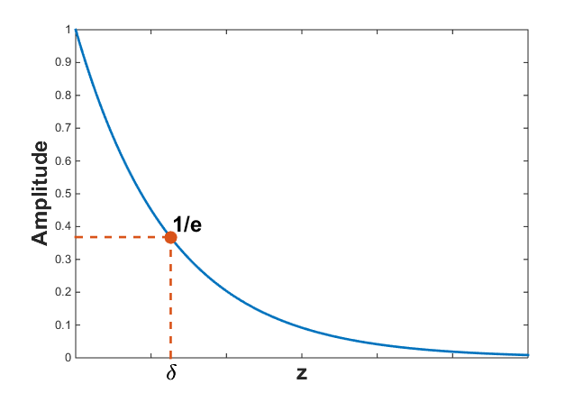
Skin depth
The skin depth is the travelling distance of EM wave in the conductor when the electric field vector has decayed to a value of E_{x} = E₀e⁻¹.
Depending on conductivity, permittivity and frequency
Skin depth is defined as the depth at which the amplitude of the wave has been reduced by 1/e
This explains the electrical shielding properties of a conductor, λ_{c} is the wavelength in the conductor.
https://em.geosci.xyz/content/maxwell1_fundamentals/harmonic_planewaves_homogeneous/skindepth.html

Slide 31
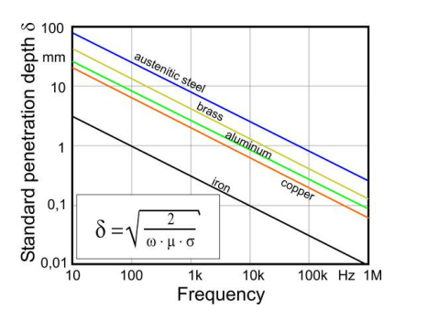
Example of skin depth for metals
Note that as the frequency of the EM wave increases, the penetration depth decreases.
This means the EM wave hardly penetrates into the conducting material.
https://www.ndt.net/article/ecndt2006/doc/Tu.3.6.2.pdf
Notes:
Austenitic steel เหล็กหล้าไร้สนิม
σ Electrical conductivity, a measure of a material's ability to conduct an electric current

Slide 32
Electromagnetic wave velocity in a conductor and anomalous dispersion
Recall the wave function in a conductor
The phase velocity of the wave υ is given by
Since the phase velocity is a function of the frequency, an electrical conductor is dispersive medium to EM waves.
Because ∂v/∂λ is negative so that the conductor is anomalously dispersive and the group velocity is greater than the phase velocity.
Notes:
https://www.quora.com/What-are-the-differences-between-conduction-current-and-displacement-current

Slide 33
Recall the illustration of dispersion relation
Since ω = kv,
This term can be either positive or negative.
↑ v ↑ : v_{g} < v (normal dispersion)
↑ v ↓ : v_{g} > v (anomalous dispersion)
Notes:
For normal dispersion ความยาวคลื่นยิ่งยาว ความเร็วยิ่งมาก คลื่นความยาวคลื่นยาววิ่ง “เร็ว” กว่าคลื่นความยาวคลื่นสั้น (v > vg)
For anomalous dispersion ความยาวคลื่นยิ่งยาว ความเร็วยิ่งน้อย คลื่นความยาวคลื่นยาววิ่ง “ ช้า “กว่าคลื่นความยาวคลื่นสั้น (v < vg)
Dispersion relation เป็นกราฟระหว่าง ω และ k

Slide 34
High frequency EM waves propagate only a very small distance in conductor.
When δ is small, the phase velocity v is small, and the refractive index c/v of a conductor can be very large. This results in the high optical reflectivity.
Determine the distance in which the amplitude of the striking EM wave drops to about 1% of its surface value.
Notes:
4.6δ = 3/4λc

Slide 35
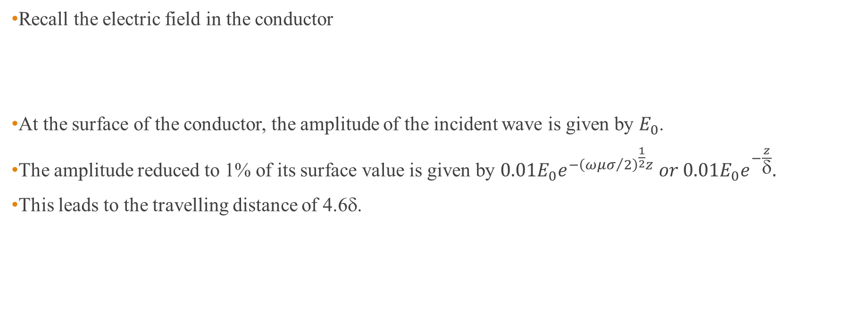
Solution
Recall the electric field in the conductor
At the surface of the conductor, the amplitude of the incident wave is given by $E_{0}$.
The amplitude reduced to 1% of its surface value is given by $0.01E_{0}e^{−{\left({ωμσ}/2\right)}^{\frac{1}{2}}z} or 0.01E_{0}e^{−\frac{z}{δ}}.$
This leads to the travelling distance of 4.6δ.

Slide 36
When is a medium a conductor or a dielectric?
The ratio of the current density is used to determine whether the medium is a conductor or a dielectric.
The conduction current dominates and the medium is a conductor :
The displacement current dominates and the material behaves as a dielectric :
Notes:
ในกรณีของ dielectric อาจมองในรูป σ/ωε < 10^-2
For a perfect conductivity σ -> ∞
For a perfect dielectric σ =0

Slide 37
Typically, an insulator has σ ≈ 10⁻¹⁵ S m⁻¹ and ε ≈ 10⁻¹¹ F m⁻¹, which gives
So the conduction current is negligible at all frequencies.

Slide 38
Notes:
ตอบคำถามแรก หมายความว่าถ้าความถี่สูงกว่า 10MHz จะทำให้เงื่อนไขของการเป็น conductor ไม่เป็นจริง
λ≈ 3 m

Slide 39
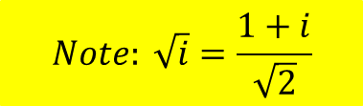
Impedance of a conduction medium to EM waves
Recall the electric field in a conductor
The corresponding magnetic filed in the conductor is given as
Given that
The impedance of the conductor is given as
By using time-dependent Maxwell’s equation
$$Note: \sqrt{i}=\frac{1+i}{\sqrt{2}}$$

Slide 40
The magnitude of Z_{C}
Recall the impedance of a conducting medium,
The magnitude can be written in terms of the free space impedance as follows,

Slide 41
Reflection and transmission of EM waves at a boundary : Normal incidence
The boundary conditions, from EM theory, are that the components of the field vectors E and H tangential or parallel to the boundary are continuous across the boundary.

Slide 42
Reflection and transmission coefficients : normal incidence
What happens to the travelling wave normally striking a perfect conductor in terms of reflection and transmission coefficients?
Due to Z₂ = 0
Notes:
A perfect conductor possesses a value of impedance = 0.
Thus good conductors are very good reflectors of EM waves.

Slide 43
Oblique incidence and Fresnel’s Equations for dielectrics
The same boundary conditions are still applied.
Two cases have to be investigated :
H perpendicular to the plane of incidence and
E perpendicular to the plane of incidence
H perpendicular
E perpendicular
Verify the direction of H_{i} in the figure.

Slide 44


Reflection and transmission coefficients : oblique incidence
For H perpendicular to the plane of incidence
For E perpendicular to the plane of incidence
$$R_{∥}$$
$$T_{∥}$$

Slide 45


Reflection and transmission coefficients in terms of refractive index n
Since
The reflection and transmission coefficients can be expressed in terms of refractive indices of incident (n₁) and transmitted (n₂)media.
$$R_{∥}$$
$$T_{∥}$$

Slide 46
Fresnel’s equations
What are the reflection coefficients at the normal incidence in terms of refractive indices?

Slide 47
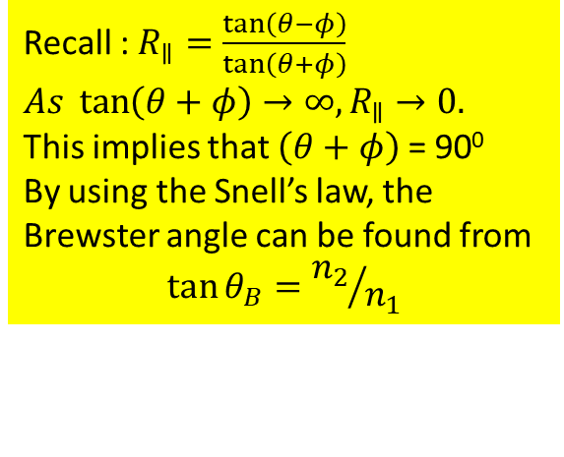
Brewster angle or polarizing angle θ_{B} can be found from
Recall : $R_{∥}=\frac{\tan\left(θ−φ\right)}{\tan\left(θ+φ\right)}$
$As \tan\left(θ+φ\right)→∞,R_{∥}$ $→0.$
This implies that $\left(θ+φ\right)$ = 90⁰
By using the Snell’s law, the Brewster angle can be found from
$$\tan{θ_{B}}={n_{2}}/{n_{1}}$$

Slide 48
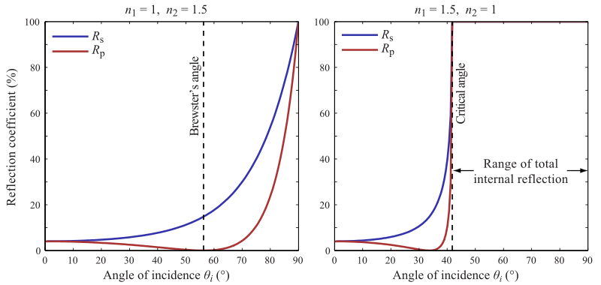

External and internal reflections at air-glass interface
$$R_{p}={\left(R_{∥}\right)}^{2} \\ R_{s}={\left(R_{⊥}\right)}^{2}$$
x100
∼4%
https://en.wikipedia.org/wiki/Fresnel_equations

Slide 49
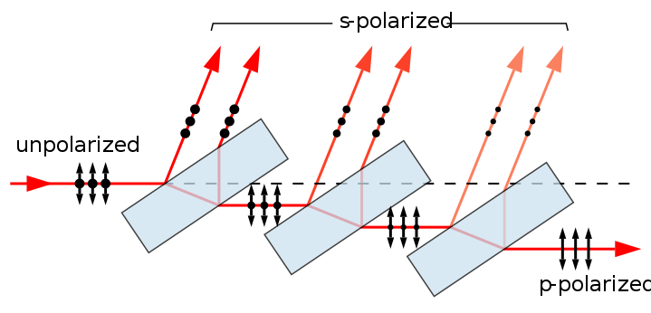
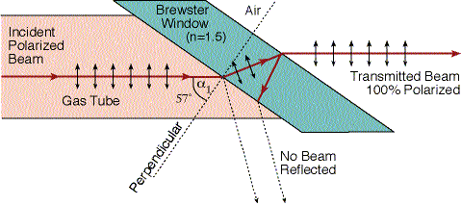
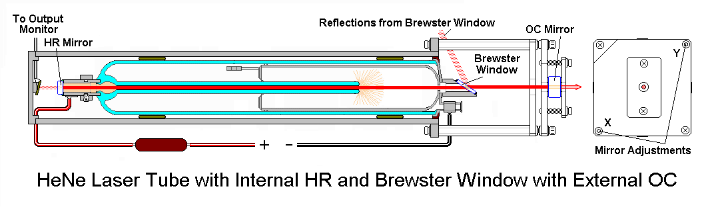
Application of Brewster angle
A stack of plates at Brewster's angle to a beam reflects off a fraction of the s-polarized light at each surface, leaving a p-polarized beam. Full polarization at Brewster's angle requires many more plates than shown. The arrows indicate the direction of the electrical field, not the magnetic field, which is perpendicular to the electric field.
https://en.wikipedia.org/wiki/Polarizer
S or P linear state of the output laser beam?
https://commons.wikimedia.org/wiki/File:Brewster-polarizer.svg
https://perg.phys.ksu.edu/vqm/laserweb/Ch-7/F7s5t1p6.htm
https://www.tau.ac.il/~phchlab/experiments_new/SemB04_Sucrose/02TheoreticalBackground.html

